Slide 1
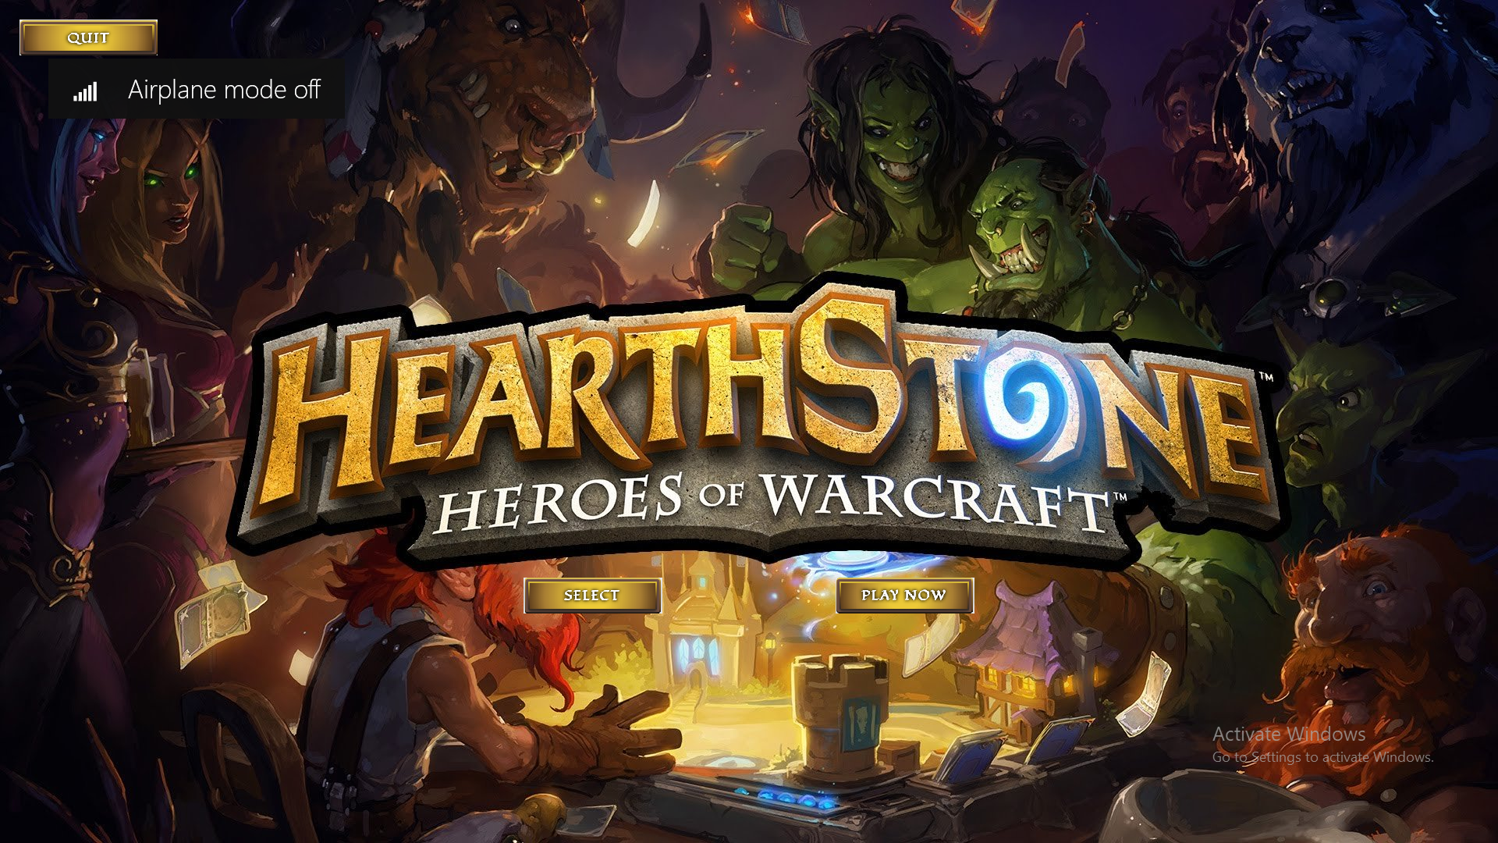
First press on select button

Slide 2

Then choose the two heroes (the first choice for the first player)

Slide 3
Then press play now

Slide 4
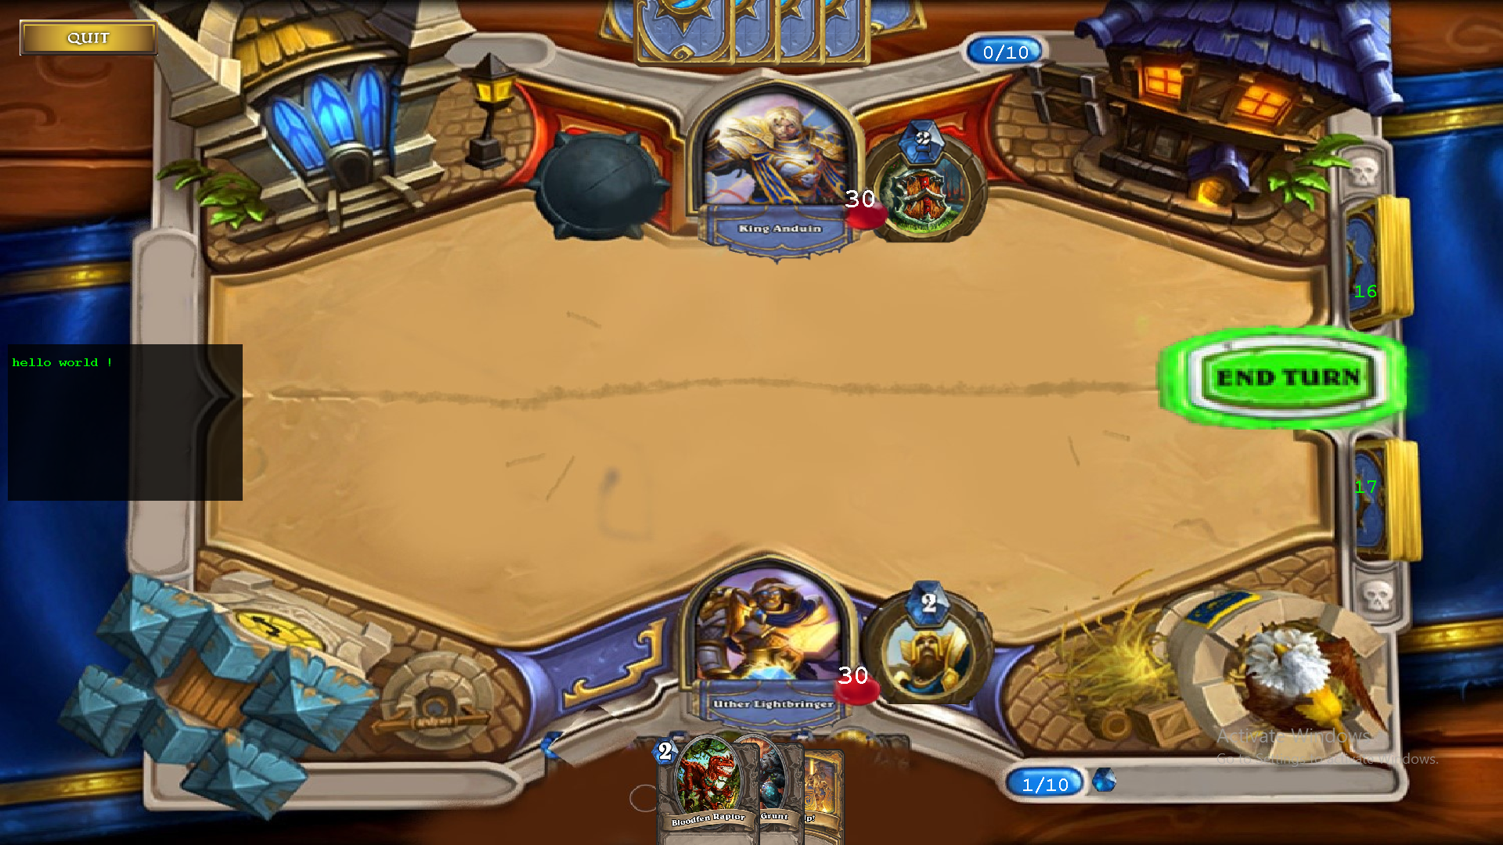
When you want to end your turn press endturn button

Slide 5
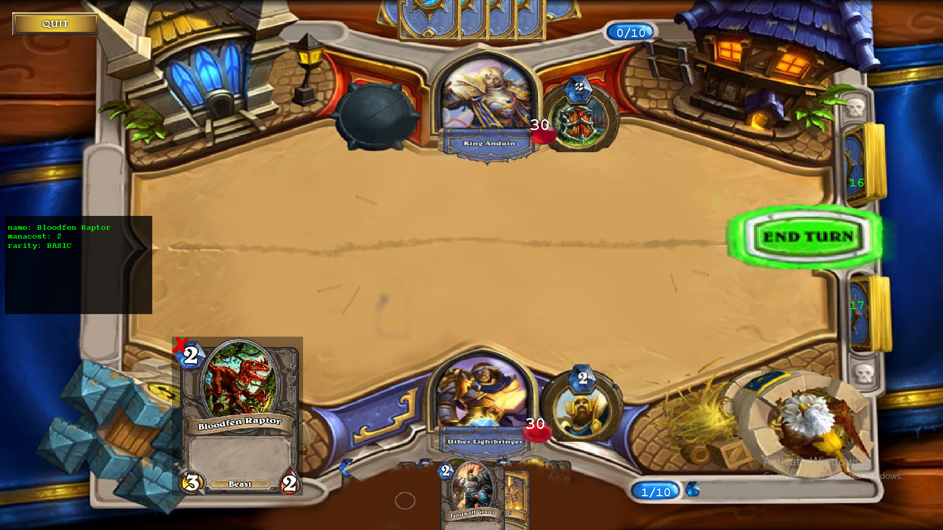
Press on any minion in your deck and it will appear on the left of your hero

Slide 6
If you click on the card if you don’t have enough mana crystal it will go back to your deck

Slide 7
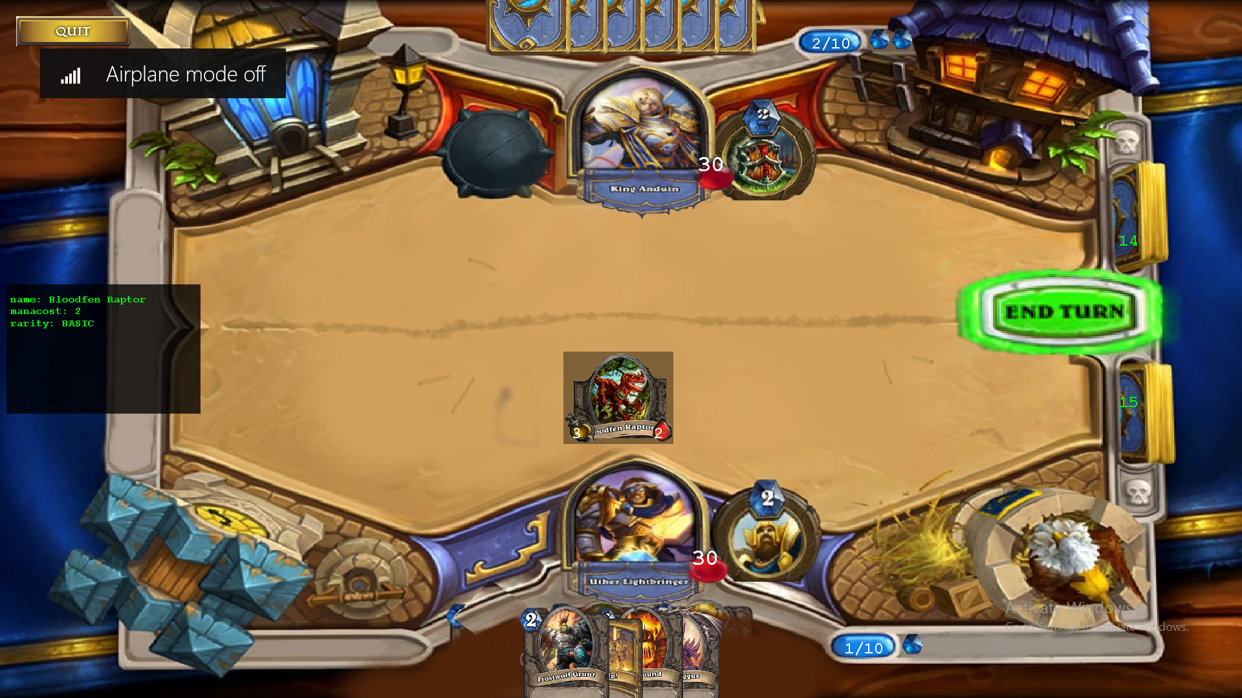
And if you have enough mana it will go from your deck to your field

Slide 8
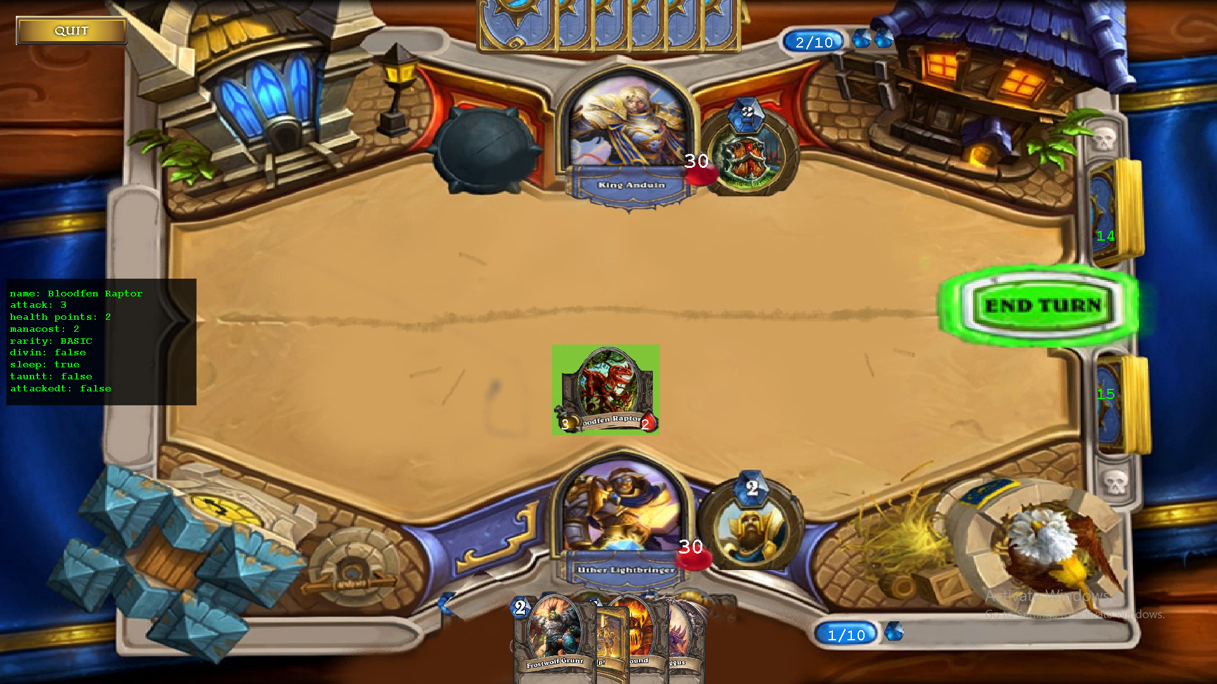
And if you click on any minion in your field and it turns to green That’s mean it’s waiting for a target to attack

Slide 9
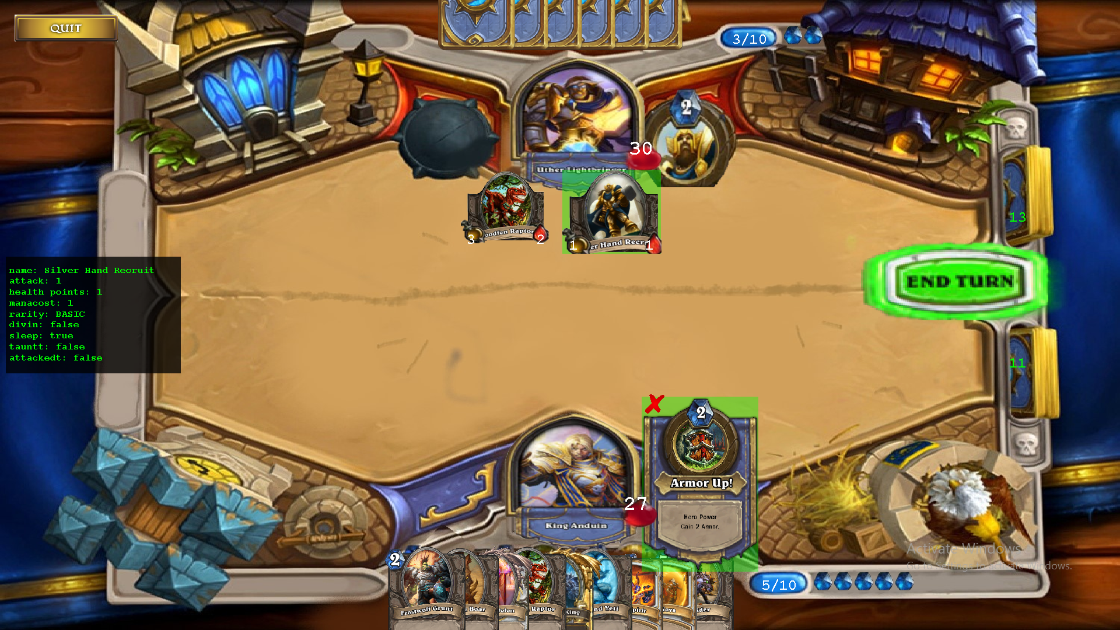
When a spell has turned to green that’s mean it’s waiting for the target

